Slide 1

Client logo goes here, vertically and horizontally centered within white area, visually similar size to Pega logo
Project <name> Kick Off
Presenter name
Title
Date

Slide 2
Welcome & Introductions
Client logo goes here, vertically and horizontally centered within white area, visually similar size to Pega logo
<provide statement about what this meeting is for – e.g. ABC Company in conjunction with partner and Pegasystems, will be replacing ABC’s legacy marketing system with Pega Marketing 7.2.
Welcome to the project kick off.
Agenda
The journey so far.
Project overview – why, what, how.
Break (@ 10am).
Solution overview.
Break (@ 10am).
Work practices & processes.
Lunch (@ 12:30).
Project schedule.
Project structure.
Break (@ 10am).
Governance.
Logistics & policies.
Team event (6pm @ location).
Notes:
Begin the kick off by clearly stating what the project is and why you are all there.
Walk through the agenda and state the desired completion time.
Run through site details such as toilets, coffee/tea facilities, if lunch is not being provided where people can buy food, etc.
Go over behaviours such as laptop and mobile phone use.
Either introduce the key attendees or go around the room and have everyone introduce themselves.

Slide 3
The Journey So Far
Client logo goes here, vertically and horizontally centered within white area, visually similar size to Pega logo
Explain the client business – who they are, what they do

Slide 4
The Journey So Far
Client logo goes here, vertically and horizontally centered within white area, visually similar size to Pega logo
Business challenge
Pega’s response

Slide 5
The Journey So Far
Client logo goes here, vertically and horizontally centered within white area, visually similar size to Pega logo
Work performed to date – inception, proof of concept, etc.

Slide 6



Project Overview
Client logo goes here, visually similar size to Pega logo
Presenter Name

Slide 7
Project Overview
Client logo goes here, vertically and horizontally centered within white area, visually similar size to Pega logo
Provide a brief statement of what the project is –
Start date.
Anticipate end date.
Type of resource model (e.g. Pega led, partner powered).

Slide 8
Project Overview
- Business Goals & Objectives
Client logo goes here, vertically and horizontally centered within white area, visually similar size to Pega logo
For example, to deploy a Know Your Customer (KYC) solution and radiate to core payment processing.

Slide 9
Project Overview
- Current State
Client logo goes here, vertically and horizontally centered within white area, visually similar size to Pega logo
With the client’s help, illustrate the current system environment.
Keep the illustration high level and brief. This is not a focus area.

Slide 10
Project Overview
- Future State
Client logo goes here, vertically and horizontally centered within white area, visually similar size to Pega logo
Illustrate the desired future end state vision.
Keep illustration high level. An opportunity to provide more detail comes later.

Slide 11
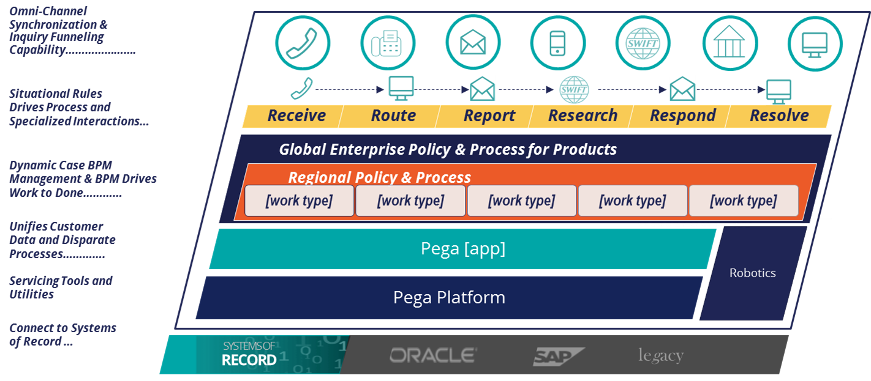
Project Overview
- Our Mutual End State Vision
EXAMPLE ONLY – do not use
Notes:
Optional & solution specific

Slide 12
Project Overview
- Enterprise Roadmap
Client logo goes here, vertically and horizontally centered within white area, visually similar size to Pega logo
Illustrate or describe this project scope in relation to the client’s overall enterprise roadmap.
Describe what is currently deemed as the highest priority for first delivery.

Slide 13
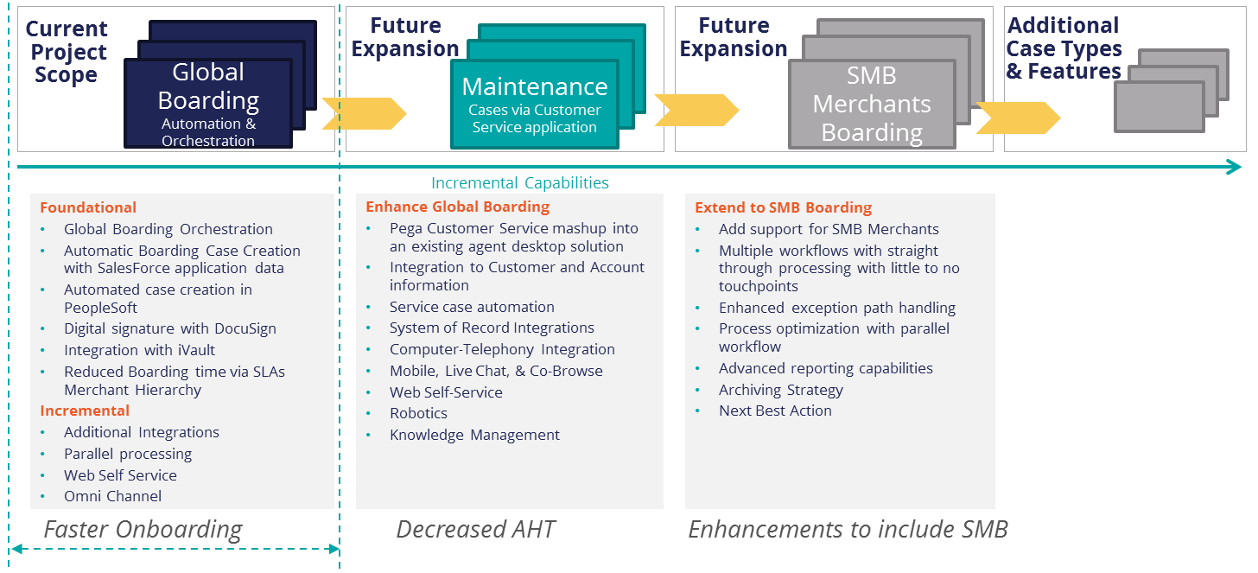
Enterprise Roadmap
EXAMPLE ONLY – do not use
Evolution of end state solution – across future expansion
Notes:
Content will be project/solution specific

Slide 14

Project Assumptions
aaoinfnoafboe
afljagfpjna
Afolbnfaobfib
Notes:
Emotional Impact – Appeal to emotions by showing examples in the customer’s business
Narrative - Think of what this could cost you, both in terms of hard dollars, lost opportunity, and in terms of your personal brand. Large enterprise projects sometimes occur just once in a person’s career. The kind of failures that Standish and Mckinsey reference can have a significant impact on how you are perceived within the organization.
Taking a more positive outlook, there is a real opportunity to be a change agent here. To embrace agile, deliver the first phase of the system in as little as 90 days and demonstrate to the organization the kind of outcomes that can be obtained as a result.
Presenter Note - This slide should be tailored to relevant examples that impact each customer if possible. For more bullets, can you possibly cite facts about the rate of change and why they need faster time to value, or the number of catastrophic project failures that risk the companies very existence (McKinsey or others call them Black Swans)
Industry stats about change
Average age of companies on the Fortune 500 list compared to 10 years ago, etc or average number of years on the F500 list (it’s no longer the 100 year old companies)

Slide 15

Risk
If this happens, then this will happen
If this happens, then this will happen
If this happens, then this will happen
If this happens, then this will happen
Key Project Risks
Notes:
650 named organizations
153 Key + orgs that will receive significantly more attention and inform target hiring as capacity expands
Ongoing analysis of engagement quality at these organizations to ensure that key personas are being targeted for each solution area
We’ve simplified our engagement strategies / solutions and drastically refocused our target org population to drive breadth and depth of engagement

Slide 16

15 minutes

Slide 17
Solution Overview
Client logo goes here, visually similar size to Pega logo
Presenter Name

Slide 18
Solution Overview
Client logo goes here, vertically and horizontally centered within white area, visually similar size to Pega logo
Illustrate or describe the solution. This slide is a place holder. It may take several slides to describe the solution. The information should be detailed enough to help the project team understand what needs to be achieved. This part of the kickoff should be interactive with a lot of discussion.Include at a minimum the following:
Strategic applications involved.
Host infrastructure (e.g. cloud, on-prem).
Data sources.
Interfaces.
Channels.
Integration.
Special considerations (e.g. trial use of a product).

Slide 19





Pega Proposed Architecture
EXAMPLE ONLY – do not use
Pega Virtual Private Cloud
Pega Cloud Operations
User Tier
Database Servers
Load Balanced
Data Replication
https
https / VPN
PLATFORM
https / VPN
Firewall
Encryption
Application Servers
Database Servers
Enterprise-grade Cloud Service
Hardened security
Continuous lifecycle support
PEGA Integration
- Services - Connectors
* SOAP * SOAP * HTTP
* HTTP * REST * FTP
* REST * SAP * DocuSign
* EMAIL * JMS * IBM MQ
* SAP * Logs * Bix Extracts
PRIVATE GATEWAY (VPN Tunnel)
Integrate your corporate intranet without exposing private services to the internet
Fastest time-to-value option
Designed for business continuity and scalability
Secure back-office integrations
Core Systems

Slide 20
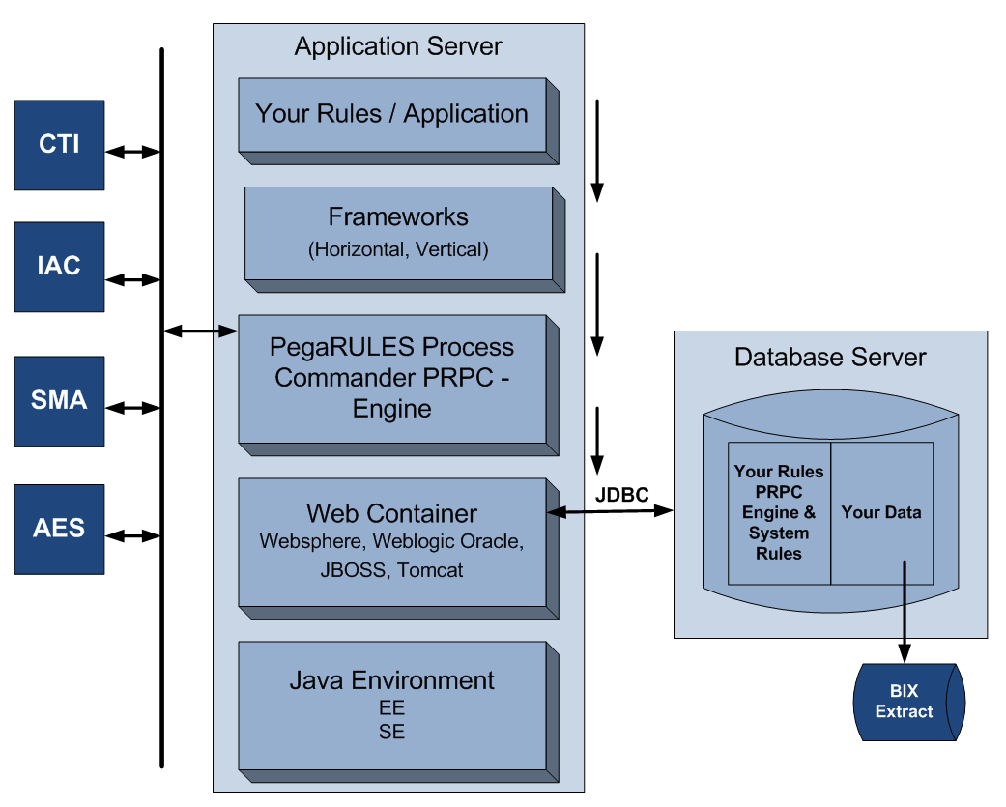
Application – Data Sheet
EXAMPLE ONLY – do not use
Production Users
  400 Call Center Associates & Managers
  800 Back Office Agents
Application Stack (PegaCloud)
  Customer Service 7.31
  Pega 7.3
  Tomcat (web container)
  Postgres (database)
Platform & Applications:
  Pega 7 Platform
  Pega Customer Service
  Pega Call
  Pega Chat
  Pega Social Engagement
  Pega Knowledge Management
  Pega Mobile Client
  Pega Web Mashup
  6 Services and Connectors
  Robotic Desktop Automation (RDA)
  Workforce Intelligence (WFI) (90 day trial)
  Predictive Diagnostic Cloud (PDC)

Slide 21
Solution Overview
- Out of Scope
Client logo goes here, vertically and horizontally centered within white area, visually similar size to Pega logo
Describe all exclusions – be clear and thorough

Slide 22
15 minutes

Slide 23
Work Practices & Processes
Client logo goes here, visually similar size to Pega logo
Presenter Name

Slide 24
Work Practices & Processes
Client logo goes here, vertically and horizontally centered within white area, visually similar size to Pega logo
Provide a brief statement on why standard work practices and processes will help the project.
Describe best practices.

Slide 25
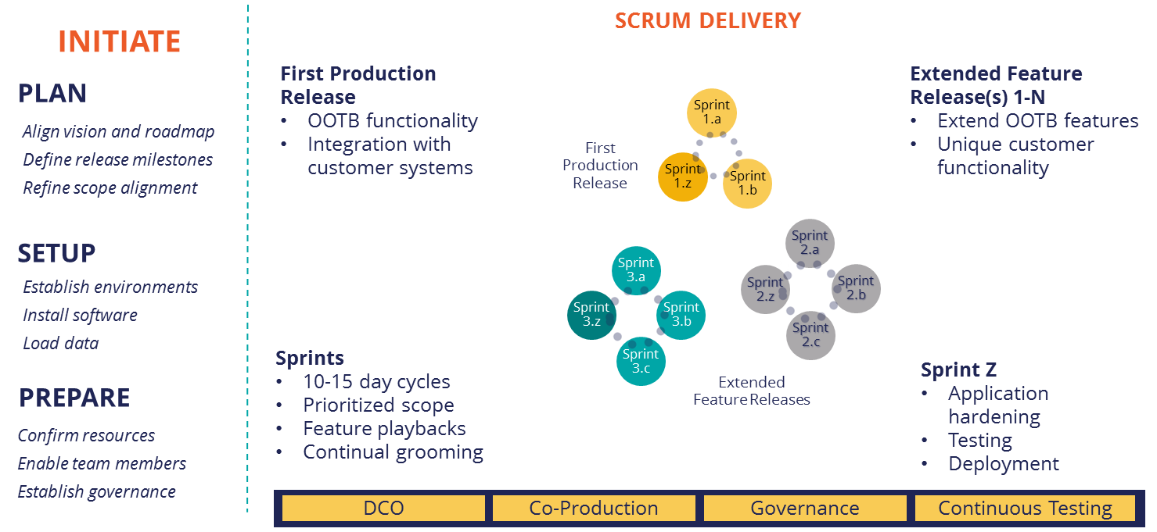
Delivery Approach
EXAMPLE ONLY !!

Slide 26
Direct Capture of Objectives (DCO)
Inputs
Activity Stages
Activities
Outputs
Artifacts
Prep drafts of Use Case sets, Analyse Processes
Identify questions, dependencies
Develop draft Mockup of Flows and UI
Link Use Cases, Rules, Flows and Objectives
Use Case draft
1st draft (Flows/UI)
Prep DCO
Objectives
Requirements
Application Profile
Use Cases
Flows and UI
Review & Validate Use Case Set and Mockup
Walkthrough and Adjust Drafts where necessary
Gather feedback on Flows, UI and Usability
Identify and discuss dependencies
Review and delegate parking lot and Action items
DCO Session
Updated Flow/UI/UC
Action items and plan
Post DCO
Follow-up and close Parking Lot and Actions
Update relevant Use Cases and Artefacts
Revise draft Mockup Flows and UI from Feedback
Prepare Playback session
Feedback included
Updated UC/ Flow/UI
Update Action
Iterate as necessary
Playback
Playback in a DCO or to specific interested parties
Walkthrough and validate Flow/UI changes
Confirm “to do’s” to further refine if needed
Confirm date/time for final review
Updated UI/Flows/UC
Feedback included
Date for final review

Slide 27
Systems Environment Architecture
Insert diagram or description of the environment that development will progress through.
i.e. Dev, QA, SIT, UAT, staging, Prod

Slide 28
Test Strategy
Insert diagram or description of what type of testing and how it will be performed and by whom. List the tools to be used. Also include how defects should be handled.

Slide 29
UX / UI Strategy
Insert description of the UX/UI approach.
Present standards that all developers should adhere to in order to prevent rework.
Find out if there is a client skin available for use. If not, find out when will one will be made available.
Find out if there are branding standards that should be adhered to. If so, what are they?
Determine at what point in the schedule the UX will be involved in the project and for how long.

Slide 30
Tools
List all the tools and for what purpose they are being used.
Ask the project team to confirm that they all have access prior to the commencement day.
Provide details on how to get access if they don’t already have it.

Slide 31

1 hour

Slide 32
Project Schedule
Client logo goes here, visually similar size to Pega logo
Presenter Name

Slide 33
Project Schedule
Select Assumptions:
UAT will be handled by MC and time boxed in duration.
Testing duration will need to be handled within sprint durations to adhere to completion date.
Program will fully leverage DCO.
Post Production Support is not depicted in plan.
Timescale below is approximate and subject to change by Sprint after Sprint 0 planning.
EXAMPLE ONLY !!
Mm/yy | Mm/yy | Mm/yy | Mm/yy | Mm/yy | Mm/yy | Mm/yy | Mm/yy | Mm/yy | Mm/yy
Weeks 1-4 | 5-7 | 8-10 | 11-13 | 14-16 | 17-19 | 20-22 | 23-25 | 26-28 | 29-34
Sprint 0 | Sprint 1 | Sprint 2 | Sprint 3 | Sprint 4 | Sprint 5 | Sprint 6 | Sprint 7 | Sprint 8 | Sprint Z
Highlights: Dev Environment Setup High Level Architecture Security, permissions, access control Team onboarding Initial Pega Training Hardware Sizing Project Planning Organize User Stories High Level Project Plan Define Sprint schedule DCO Session Planning Define Governance Plan Finalize Team Allocation Application Profile Work |  |  |  | Sprint 4 | Sprint 5 | Sprint 6 | Sprint 7 | Sprint 8 | Sprint Z
 | Dev Sprint 1 Manual and electronic case creation Business logic configuration per client Isolation of customer data Interfaces AcqOutgoingNSDAdj Auto Chargeback Cardholder Adjustments CreateExceptionCase Data Navigator | Dev Sprint 2 [fill-in] work types [fill in] processing Interfaces Direct DB2Queries DispEngineCreateCase Electronic Warning Bulletin EmailGateway | Dev Sprint 3 VCR change support Data mapping for VROL Interfaces Event Tracker DB FeePurseAdj FeePurseQuery Fraud Flow Fraud Reporting | Dev Sprint 4 Search for Merchant Credit PIN and Pinless debit disputes Interfaces IssuerWFService LDAP Negative Notification OtherChargeBacks PinChgBackBase24 Sprint 4 Transition/UAT SIT Test Sprints 1-3 UAT planning | Dev Sprint 5 Regulatory compliance – Reg Z/ Reg E Interfaces QueryPMTxns SigChgBackPaymtsMgr USAA Web Service VROLIn VROLOut Sprint 5 Transition/UAT SIT Test Sprint 4 UAT Test Sprints 1-4 | Dev Sprint 6 Network accommodations / coverage Correspondence Interfaces MasterComProIn MasterComProOut Sprint 6 Transition/UAT SIT Test Sprint 5 UAT Test Sprints 1-5 | Dev Sprint 7 Mastercard ATM acquirer flow Fraud scenario work Technical backlog Sprint 7 Transition/UAT SIT Test Sprint 6 UAT Test Sprints 1-7 Production Setup | Dev Sprint 8 Reports Technical Backlog Sprint 8 Transition/UAT SIT Test Sprint 7 UAT Test Sprints 1-7 Performance testing | Sprint Z Transition / UAT SIT Test Sprint 8 UAT Test Sprints 1-8 Production Setup Performance testing Go / No-go decision
ESTIMATED SCRUM DETAILS
Sprint |  | Start Date | End Date | Sprint Length (wks) | Num of Sprints | Duration (wks)
Sprint - 0: |  | 10/17/2016 | 11/11/2016 | 4 | 1 | 4 | 0
Sprint 1 - N: |  | 11/14/2016 | 4/28/2017 | 3 | 8 | 24 | 4
Sprint - Z: |  | 5/1/2017 | 6/9/2017 | 6 | 1 | 6 | 28
 |  |  |  | Total: | 10 | 34 | 34
Notes:
MLP schedule to include details about each sprint.

Slide 34
Project Structure
Client logo goes here, visually similar size to Pega logo
Presenter Name

Slide 35
Project Structure
EXAMPLE ONLY !!
[Client]
PEGA
Account Executive
(supporting)
Steering committee
Governance
Practice Lead
(supporting)
Technical Architect
(supporting)
Engagement Lead / Scrum Master
Project Management
User Experience
(supporting)
Product Owners
Lead Business Architect
Lead System Architect
Agile Testers
SME’s
IT, infrastructure & Operations
Change Management
Business Architect
Senior System Architect
(3 onshore / 4 offshore)
Business Architect
x2
System Architect
x 2

Slide 36
Roles & Responsibilities
The following represents Pega resource roles and responsibilities for a Pega-led project where Pega provides the key project resources for completing the first release of the project.
Role | FTE | Responsibility/Work
Engagement Leader | 1 / Onsite | Lead Project delivery including Guardrail Compliance, Project Governance, Support Project Plan and Project Methodology; drive task completion to milestones; engage "Customer" resources in co-production and Pega7 Technology adoption.
Lead System Architect | 1 / Onsite | Create functional Design, Construct Class Hierarchy and Object Models, Review Test Strategy. Support the high level scope and objectives of the project. Understand the process of the function in scope to enable implementation.
Lead Decisioning Architect | 1 / Onsite | Decisioning and NBA Marketing product SME. Ensures alignment between business requirements and DSM product capabilities. Leads and reviews Decisioning product catalog and fulfillment detail design.
Senior System Architect | 1 / Onsite | Implement Activities and Methods, Implement Pega-Responsible Services and Connectors
Sr. Decisioning Architect | 1 / Onsite | Builds and maintains business logic and strategies / adaptive models. Tests changes to business logic. Runs simulation process and reviews output with analytics team.
Deployment Architect | 1 / Onsite as needed | Installation of Pega software for Development and other environments ensuring adherence to best practices and client knowledge transfer, client will shadow and own installation of follow-up environments with Pega support.
Senior Business Architect | 1 / Onsite | Assist in facilitation of requirement elaboration and development, align requirements to design and development artifacts.
Practice Leader | .1 / Remote and Onsite | Governance, Executive Support, Escalation
Solution Design Review | Remote and Onsite | Assessment and recommendations of overall solution design prior to development and detail reviews during development.
UX Review | Remote and Onsite | Assessment and recommendations of UI usability prior to design start; UI design review; guidance and review during development.
Deployment Review | Remote and Onsite | Assessment and recommendations for Pega rules and business logic deployment and overview of Revision Management capabilities.
Performance Review | Remote and Onsite | Assessment and recommendations of production performance for “go live” and future releases.

Slide 37


Co-production
Empower business to build for change
Increase Business & IT Collaboration Through DCO
  Easily capture application intent, requirements, and specifications.
  Prioritizes deliverables, clarifies scope and schedule, and reduces churn.
  Build out the high-level case structure with a Case Management and Control layer.
Accelerate Learning
  Accelerate time to go live as resources “learn by doing.”
  Work shoulder to shoulder in a true team effort immediately following enablement.
  Build in-house competence and confidence to maximize ROI.
Maximize Quality
  Co-production leads to high guardrail scores on application quality.
  Keeping business and IT aligned through frequent playback sessions.
  Continually iterate for business value.
Notes:
co-production strategy based on empowering bus to model their bus and build for change
Business users have the tribal knowledge, live, eat, and breath your business, they know what you do today and what it should be in the future – pick and dedicate your top, best people as there is a direct correlation between the time we spend with them and the value you receive
Start project immediately after enablement – true team effort working shoulder to shoulder to cement knowledge and understanding – configure as a team, building together to mentor and show how easy to change, easy to upgrade, each to manage
features/caps -DCO,
Case Lifecycle Management,
Pega Express
compelling bus UX to model their bus –
We continue to roll out tools and improvements –
our model driven approach abstracts the “plumbing”

Slide 38
Training and Enablement
Key client target roles recommended:
  Business (Business Architect) x 2
  Technical (System Architect) x 2
Recommendation that initial training is undertaken through mentored self-study. Subsequent training can be online or classroom based.
Continuous development through on-the-job mentoring plus regular assessment on skills and gaps.
  Clear enablement plan supported by regular checkpoints.
  Coaching and mentoring while embedded within the project team under leadership of Pega Lead Business Architect and Lead System Architect.
  Immediate focus upon delivering early value.
  Medium term goals through objective based enablement to support future phases and continuous improvement through 2018 and beyond.
10%
Formal learning - training
20%
Learning from others – coaches, mentors, feedback
70%
Learn by doing – through challenging assignments and experiences

Slide 39
Client Enablement Strategy
EXAMPLE ONLY !!
One key to success is to have a fully enabled team from the client to aid co-production:
Pega System Role Types (Client Role Alignment) | Course and Certification (as applicable)
System Architect (Technical Developer) | System Architect Essentials (CSA)
Senior System Architect (Senior Technical Developer) | Senior System Architect (CSSA)
Lead System Architect (Technical Lead) | Lead System Architect (CLSA)
Business Architect (Business Analyst) | Business Architect Essentials (CPBA)
Product Owner | Product Owner Role in Scrum
Program / Engagement Leader (Project Manager) | Pega Platform Foundation
User Experience Specialist (Human Factors) | UI Specialist (CUIX)
Pega Stakeholder | Pega 7 Fundamentals
Program Manager
Legend
Pega Expert Skills Required
Core Pega Skills Required
EL
LBA
LSA
SBA
SSA
SSA
SME
SA
SA
BA
SME
SA
SA
BA
SA
SA

Slide 40
15 minutes

Slide 41
Governance
Client logo goes here, visually similar size to Pega logo
Presenter Name

Slide 42
Governance Meetings
Provide specific names here – confirm all information is correct for this project
Forum
Frequency
Participants
Discussion Topics
Escalations
Executive Governance
Enterprise Alignment
Client Senior Executives
Partner Senior Executives
Pega Senior Executives
Alignment of corporate strategies
Overall relationship discussion
Executive-level issue resolution / escalation
Long term business roadmap discussion
Quarterly
Client : Department Heads
Partner : Account Lead
Pega : Region Leader, Practice Director, Account Executive, Practice Leader
Contract management and metrics
Coordinate / integrate business strategies; address cross-program issues
Understand current status & priorities
Review performance metrics /satisfaction
Confirm actions by all stakeholders
Program Governance
Account Strategy Meeting
Monthly
Client : Project Team Leads, Project Dept. Heads
Partner : Project Team Leads, Practice Lead
Pega : Project Team Leads, Practice Leader, Account Executive
Cross department coordination/ collaboration – confirm current priorities
Facilitate effective interaction at operational level between all stakeholder parties
Plan analysis scope, schedule, budget
Confirm actions and dependencies
Escalate issues / risks to management level
Cross-Department Review
Stakeholder Governance
Bi-Weekly
Project
Governance
Daily Standups
Client : Project Team Members, Team Leads
Partner : Project Team Members, Team Leads
Pega : Project Team Members, Engagement Lead
Project level day-to-day governance
Project team Issue/risk management / escalation to program sponsors
Current project status reporting for plan analysis, scope, schedule
Change management
Daily

Slide 43
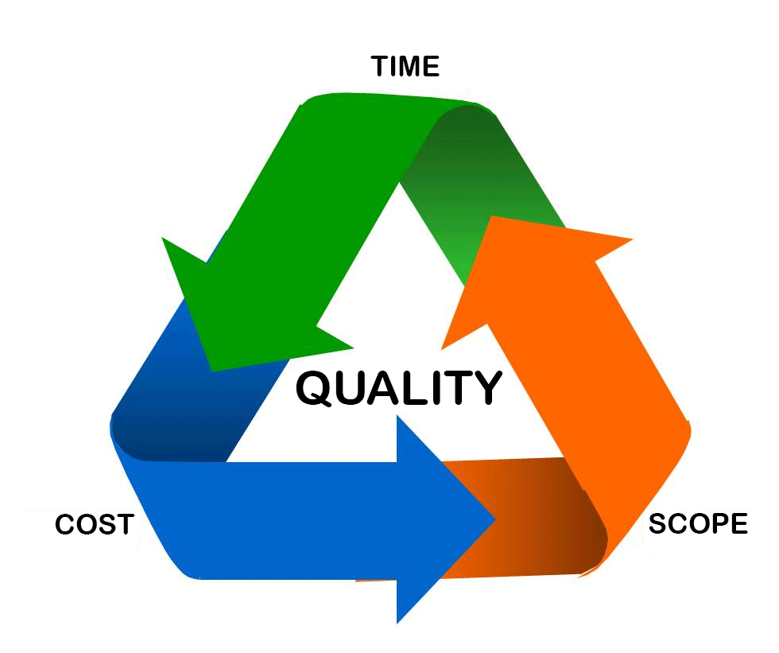
Tracking
Client logo goes here, vertically and horizontally centered within white area, visually similar size to Pega logo
Scope
  Product Owner will control using the backlog.
Time / project activity
  How much has been completed.
  How long it took to complete.
  How much more is there to do.
  Log in Agile Studio.
Budget
  Timesheets.
  Expenses.
Quality
  Playbacks.
  Pega guardrails compliance scores.
  Defect management.
Co-production
  Enablement progress.
  Certifications.
  Project work activities (productivity).

Slide 44
Monitor and Control
- Risk & Issue Management
Client logo goes here, vertically and horizontally centered within white area, visually similar size to Pega logo
Risks will be reviewed at the following intervals:
  Project commencement.
  Weekly project meeting.
  Sprint planning.
Risks will be assessed according to probability and impact; any risk with a score above <insert client agreed score> will have an active mitigation plan put into effect.
It is the responsibility of the entire project team to identify and ‘call out’ any potential risks.
Issues will be reviewed at the following intervals
  Daily in project stand-up meeting.
  Weekly project meeting.
  As needed.
Issues impacting the successful completion of a sprint will be immediately addressed.
All other issues will be managed in accordance to their priority as agreed between the entire project team.
It is the responsibility of the entire project team to identify and “call out” any issues that arise.

Slide 45
Monitor and Control
- Change Control
Client logo goes here, vertically and horizontally centered within white area, visually similar size to Pega logo
Product Owner manages the backlog, thus determining the scope sprint by sprint.
If the scope changes or additional scope added, the Product Owner will either:
  Remove other items of the same effort size from the backlog that are no longer deemed important; this will keep the size of the project the same.
  OR
  Will add the new scope to the backlog to be included in a future sprint according to the priorities; this will increase the size of the project and will therefore generate additional effort and cost.
Changes will not be added to sprints that are underway .
It is the responsibility of the entire project team to identify and “call out” any changes to scope; the success of the project has been planned based on the initial scope; failure to “call out” scope changes could result in the project failing.

Slide 46
Logistics & Policies
Client logo goes here, visually similar size to Pega logo
Presenter Name

Slide 47
Logistics & Policies
Client logo goes here, vertically and horizontally centered within white area, visually similar size to Pega logo
Describe the working environment and the client’s company policies. This may take multiple slides.
Document management & storage.
Equipment.
Travel expectation.
Expenses (hotel, car, etc.).
Work hours.
Flexible work arrangements.
Onsite/offsite.

Slide 48
Wrap Up
Client logo goes here, visually similar size to Pega logo
Presenter Name

