Slide 1
Pega Weekly Status Report
Customer Name, Project Name
Notes:
To change the date and footer text, select INSERT | Header & Footer, then set the checkboxes you want to update. Finish by selecting Apply to All, which will update all the slides with your values.

Slide 2
Overall status
 | Current | Prior | Back to green actions
Overall | Y | R
Customer Success | G | G
Legal | G | G
Schedule | Y | Y
Budget | G | G
Technical | G | Y
Resources | G | G
Guardrail score | Weighted score = |  | Compliant rules % = | Total number of rules =
Defects | Number open = |  | Number resolved = | Number of critical =
Summary and key achievements | Key issues and risks
Notes:
These should be the same as reported in the ESU.
Be sure to flag as issues/risks anything you need Client help to resolve
If the project is in Triage (technical or business) or situation management, then call out in the Key Issues/Risks if appropriate. It may not always be relevant to do so, depending on the nature of the problem, but in most cases we should state this.

Slide 3
Schedule and dependencies
Details
Infra/Install delayed the schedule by ~ 5 weeks - Sprint 1 commenced 13/3 Interface delivery from clients UI due 22/4 – pega sprint 2 dependent on this
13/3 22/4 6/5 25/5 4/6 8/7
Data Capture Interfaces
Make Lending Decision
Existing Customer Interfaces
Anti Fraud Interfaces
Fulfilment & Compl. Interfaces
Go Live
Team 1
Make Lending Decision
Anti Fraud Checks
Fulfillment & Compl.
Team 2
Notes:
Use a simplified form of the project plan for the project that shows major milestones. Do not use a detailed MS Project or similar as it is usually hard to understand out of context. Usually this does not change much from week to week, but keep up to date as it does change.
Call out any dependencies, especially ones outside the Pega team (ie: other vendors / other client teams), and any variances to the plan

Slide 4
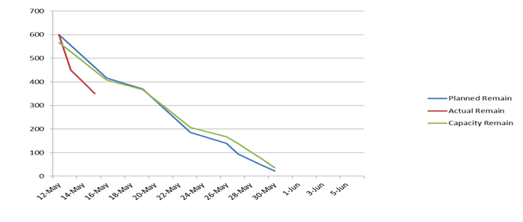
Progress metrics
User story burndown | Defect burndown
Next deliverables | Business impact (from Day 1 strategy)
Acquisition journey | Decommission old acquisition system for team X & Y Split new customers by region to the new system
Notes:
Burndown charts should be produced from Agile Studio where possible, or whatever tool is in use to manage and track work (ie: Jira / TFS / excel etc)
For defect tracking, be sure to distinguish between Defects that are qualified pega defects, uncategorised so far, new requirements, other system, bad data, bad test, user error etc.
Continue to call out the business impact of the next deliverables so we remain aligned with the Day 1 Go Live strategy

Slide 5
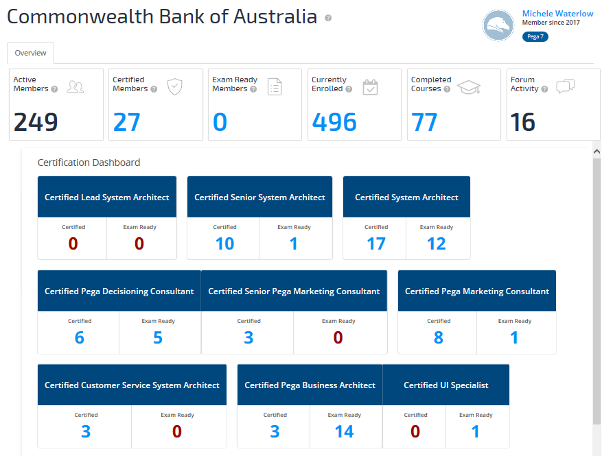
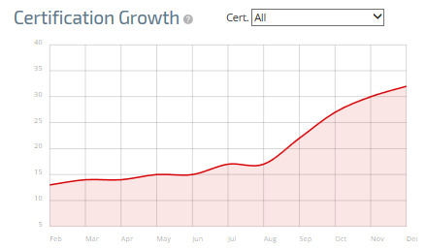
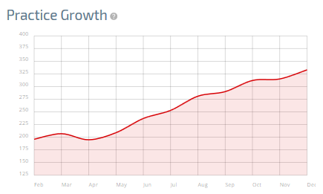
Co-production
Client staff name | Target activities | Next goal | Due date | Status | Back to green actions
Kerr Avon | Security testing | Penetration test | 2 Nov 2018 | G
Villa Restic | Acquisition user story | Take over as lead for acquisitions | 18 Dec 2018 | G
Overall status
Co-production resources are working as part of the development team 1 missing resource based on agreed price. Need to agree if this work will be done by Pega via change control or we change scope.
Current | Prior
G | Y
Notes:
Call out any issues with co-production If Co-production has issues and Pega has to do more work then we need to agree if we deal with this by changing scope / more paid effort from Pega or some other solution.
The report can be pulled from PegaAcademy and should be updated weekly.

Slide 6
Budget
Scope / change requests |  | Resources
CR-XX added to the backlog on 23/05 – approved by XX – impact is 1 additional sprint at a cost of $XX |  | Roj Blake on leave xx to xx Kerr Avon on leave xx to xx Jenna Stannis joins project xx
Original # of sprints - | # of sprints after changes -
Notes:
Taken from Projector default view of Estimate at Completion vs. Budget at Completion. This view looks at the actuals to date, the estimate to complete (the work left to do to complete the contract) and the estimate at completion (actuals to date + estimate to complete) versus budget. In this example, based on the estimate to complete we will be over budget by $1,200 at the end of the project. Projector calculates the estimate to complete based on the number of hours resources are booked for on the project. It is very important to keep the resource scheduling on the project up to date to ensure Projector calculates the most accurate estimate to complete. For example, if you do not add holiday/training absences then you may show as going over budget at the end of the project.
Be sure to call out change controls that may impact this budget, and resource changes that may also impact the budget.

Slide 7
Optional Slides – Use As Appropriate Delete This Slide Before Using

Slide 8
Obstacles to success
Risks
A
B
C
Issues and blockers
A
B
C

Slide 9
Change control log
CC ID | Status | Description | Approval date | Budget change
2 | Open
3 | Open
4 | Pending
The Product Owner has the absolute right to swap functionality and change scope, but if the total size of the backlog rises, the extra work is subject to change control

Slide 10
Tasks
Accomplished this week
A
B
C
Planned for next week
A
B
C

Slide 11
Support Request Summary
Issue ID | Description | Status | Est due date | Resolved | Assigned to
 |  | G
 |  | Y
 |  | G
 |  | G
SR status | Count
Open | 4
Closed | 0
Blocked | 0
Needs Immediate Attention
No Change
SR Summary
Needs Attention
Improving
G
On Track
Worsening

Slide 12
Environments status as of [Month] [Day]
Completed Items
Verified improved performance post configuration of App/DB server colocation
QA and other environment changes are complete with the exception of a few items targeting completion this week
Refer to table below for additional Performance Tuning recommendations
In Progress Items (with Kishore’s team targeting completion 9/7)
Implement remaining performance recommendations from Dean/Mike per table below (yellow)
Received hotfixes have been installed to SIT for Regression testing prior to QA deployment for Performance Testing
Outstanding issues
Ensure proper authorization setup to hit endpoint URLs in all environments, e.g. RightFax
Drive closure of outstanding SRs (4 still open) 3 related to errors in logs, 1 related to UI rendering issue
Cisco CTI Requirement on CSS environment, only for CSS, will be done for CSSLS for phase 2
App Dynamics licenses needed for SIT/UAT in order to debug ALS Services related latency issues
PDC is going through the XXXX Bank process to be utilized by Go-live. The CoE is in conversation with the ARB. InfoSec and the Cyber Security Consulting Team.
S # | Team | Description | Dev LWSPNCB00009D16 | SIT LWSPNCB00009S09 | UAT lwsprib00001q24 | QA LWSPRIB00001Q17, 1Q18, 1Q19 | Prod LWSPRIB00001049, 1050, 1051 | Training LWSPRIB00001R01
1 | MW | GC policy (balanced) | balanced Done 8/31 | balanced Done 8/31 | balanced Done 8/28 | balanced Done 8/27
2 | MW | Heap size (both min & max to 8gb) | 8192/8192 Done 8/31 | 8192/8192 Done 8/31 | 8192/8192 Done 8/28 | 8192/8192 Done 8/27
3 | MW | Disable explicit GC | Done 8/31 | Done 8/31 | Done 8/28 | Done 8/27
4 | MW | Web container Thread pool setting (set to 200) | Done 8/31 | Done 8/31 | Done 8/28 | Done 8/27
5 | MW | Webspehere settings (Steve Gill), § Add elapsed timestamp (http, access log) | Done 8/31 | Done 8/31 | Done 8/28 | Done 8/27
6 | Unix | Server level changes - Add Memory | 43 GB | 43 GB | 32 GB | 44 GB
7 | Unix | Server level changes - Add CPU cores | 4 CPU 2 Cores | 4 CPU 2 Cores | 2 CPU 1 Cores | Each server has 6 CPU 3 Cores | Each server has 6 CPU 3 Cores
8 | Unix | Server level changes - limit changes per server | Need confirmation | Need confirmation | Need confirmation | Done | Done
9 | App D | App D | N/A | N/A | N/A | Done

Slide 13
Key milestones
Complete
A
B
C
Upcoming
A
B
C

Slide 14
Key decisions made
Date | Comments
1 Jan 2019 | Release 1 will use pega default signon rather than SSO as the LDAP server is unavailable. This will lead to some extra work downstream to redo the login via SSO when possible.

