Slide 1
Explaining the Prepare Phase Agenda
Prepare Phase – Pega Express™ Methodology
January 2021

Slide 2
Objectives
Explain how to use the Prepare phase day by day agenda
Provide some tips to help setup a best practice Prepare phase

Slide 3
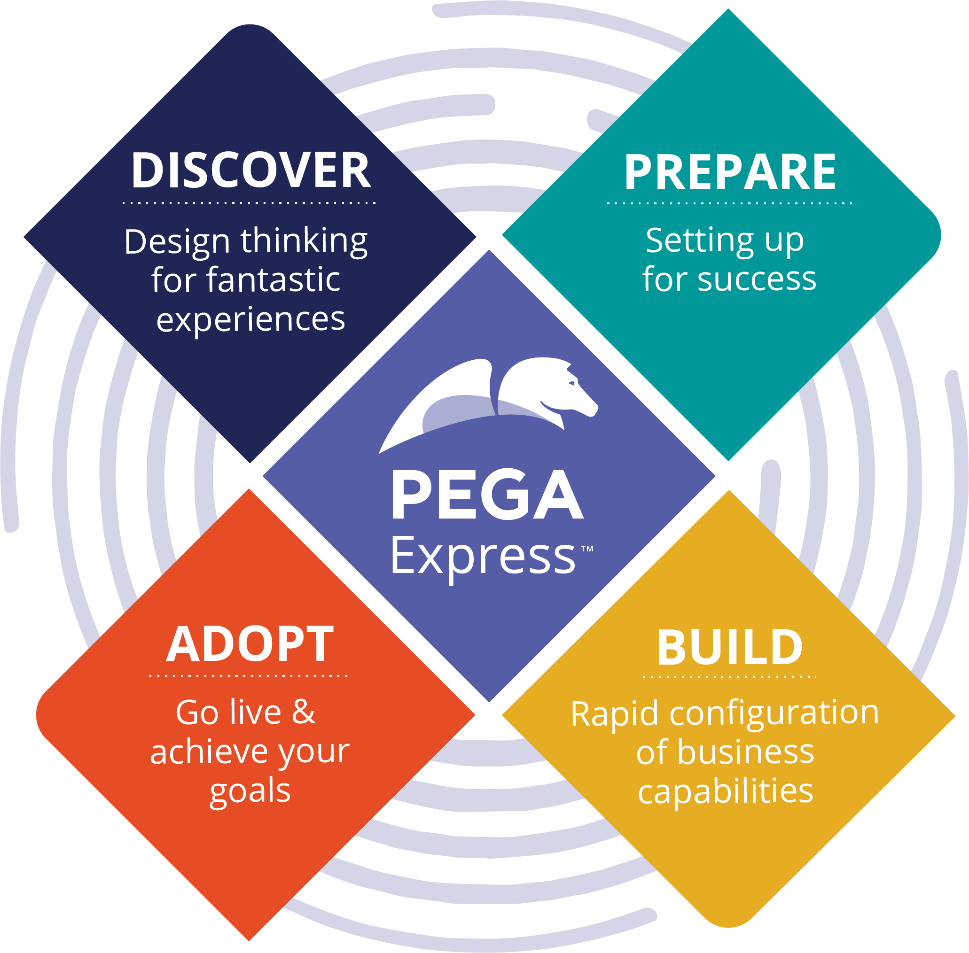
Recap: Typical Pega Express Timeline
Release 1 (MLP1) Go Live
MLP2 2 Go Live
n weeks
1 to 2 weeks
6 weeks
1 to 2 weeks
4 weeks
Discover
Prepare
Sprint 1
Sprint 2
Sprint 3
Sprint 4
Sprint 5
Sprint 6
n
DESIGN SPRINT PRE-WORK
DESIGN SPRINT
HARDENING
During Prepare, the project team get ready to start sprinting.
Note: A Design Sprint may have happened during Discover.

Slide 4
Prepare
What should you have already, before you plan?
The What
Prepare is when the Project-proper kicks off
Prepare is a highly collaborative exercise which caters for all project sizes; it can last as little as a few days to three weeks for larger projects
A consistent success factor is having strong and dedicated business representation throughout
The Who
For Pega led projects, the Consulting Services Executive (CSE) is responsible for planning Prepare, creating the agenda and agreeing the agenda with the client
The CSE may delegate this to a Project Delivery Lead (PDL)
A clear understanding of the customer journey, broken down into microjourneys™
An MLP roadmap that shows how the project will be delivered over a series of MLPs (which microjourneys are in MLP1, MLP2 etc)
If you don’t have the above, you will need to plan for journey mapping and / or a design sprint during Prepare.
A sizing; a Case Type Backlog or better still, a detailed Scrum Sizing
A Day 1 Live Plan that explains, in one slide, what will change for the business on day 1 of go-live

Slide 5
What is a Sales to Delivery Transition?
Knowledge transfer from Sales to Delivery including a dedicated workshop that helps prepare the Delivery team for successful client engagement
Sales and Delivery team members get together on day 1 of the project to discuss the client, sold services, expectations, desired outcomes, scope, risks and more…
More information is available on the Pega Express™ Toolkit

Slide 6
Top Tips before you start planning Prepare
Get context from the sales team even before the Sales to Delivery transition; you may need some critical information to help plan Prepare e.g.
Has there been an operational walkthrough? Do you need to include one during the Prepare agenda?
Has a design sprint been run during Discover? Do you have consistent resources to draw upon?
What reusable assets already exist, such as a prototype?
Engage an Experience Designer (XD) early and plan for them to be involved throughout Prepare the first one or two sprints
Use the Pega Express Toolkit to help you
the Project Readiness Checklist indicates how ready the client is to start the project

Slide 7
Planning Prepare
Best practice Prepare objectives:
Action your coproduction plan (enablement)
Use App Studio to capture the 3 pillars
Design the user experience
Create your Product Backlog
Use DCO to create 2 sprint’s worth of user stories
Establish governance structures
Every Prepare is different. Start by defining your specific Prepare objectives
e.g. if your MLP Roadmap or the solution to the problem you are trying to solve if not clear before Prepare starts, you will need to spend more time on vision alignment and journey mapping, and seriously consider running a Design Sprint
e.g. if no coproduction enablement plan is in place already, you need to allow time for this in your agenda
Day of Prepare should involve a Sales to Delivery Transition session

Slide 8
How do you decide whether you should run a Design Sprint?
How do you decide if you should run a Design Sprint?
Unknown Design
Design Thinking is incredibly powerful here
If your problem has a reasonable level of complexity and you want an effective way to tackle that problem, design thinking is a good fit.
The problem is not well defined
It’s unclear how best to proceed (open-ended)
The problem is complex because –
It contains some unknowns
There are different layers of interrelationships
It’s something you’ve not done before
You need to bring people together to –
Get consensus for what a new process might look like
Conceptualize a new solution to an existing problem
Known Design
You already have a clear vision
There is a simple solution to a simple problem or
…the problem is complicated; it is hard to build and test but leaves little room for creativity because –
There are non-negotiable regulations to adhere to
There are clearly prescribed rules e.g. FATCA
You are running an upgrade or using a pre-packed solution (e.g. a chatbot)
Increasing complexity of change
Starting Point
No Design Sprint
Design Sprint

Slide 9
5 Day Design Sprint
Day 1
Day 2
Day 3
Day 4
Day 5
Map
Sketch
Decide
Prototype
Test

Slide 10
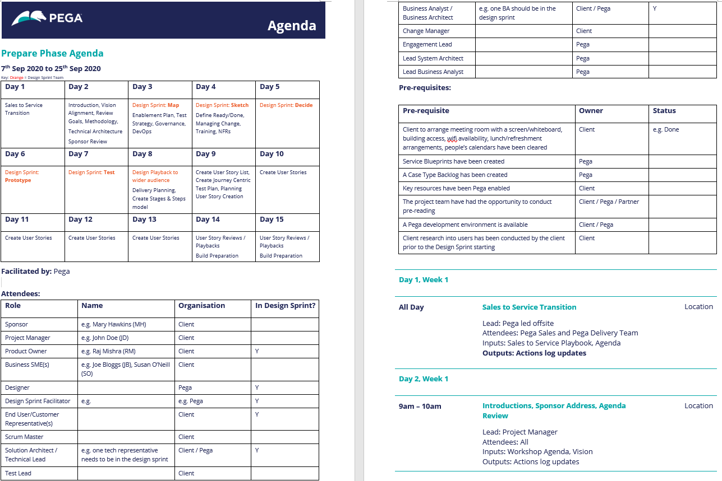
Prepare Agenda
Use the day-by-day Prepare agenda, available on Pega Community
It defaults to 3 weeks duration, assuming a complex project that includes a design sprint
The agenda has been designed to be shared and agreed with the client
The agenda can be tailored to each project, typically created by the Consulting Solution Executive or Project Delivery Leader in collaboration with the Experience Designer
Standard pre-requisites:
Case Type Backlog
Day 1 Live Plan
Pega Enablement of project team
Team have conducted pre-reading
An available Development Environment
Client has conducted user research (see below)

Slide 11
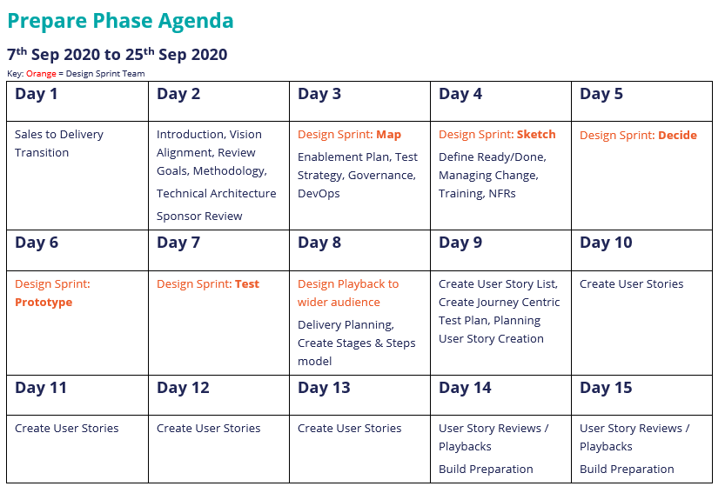
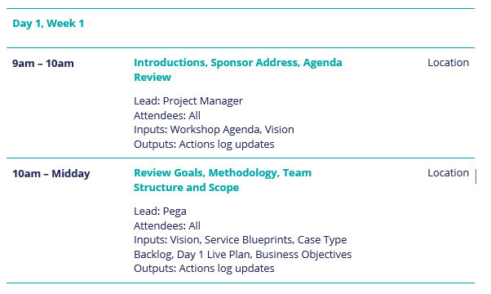
Top Section
Bottom Section
The top section summarises the day-to-day sessions:
Update the top section first, then once you are happy with it, update the bottom section.
The sections at the bottom of the agenda provide the detail for each session:
When making changes, ensure the top and bottom sections remain in sync

Slide 12
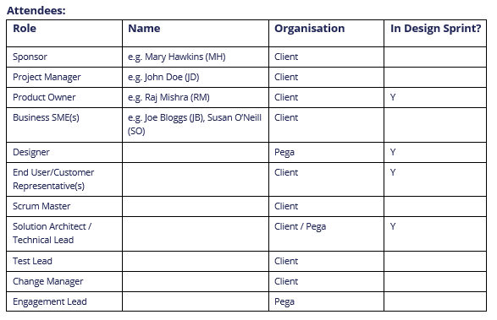
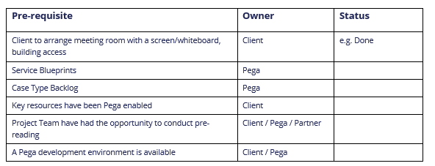
Prepare Agenda
Specify the attendee roles, names and organizations. Indicate which roles will be involved in the Design Sprint. This will be tailored for each Prepare
The pre-requisite section provides an opportunity to highlight to the whole team what needs to be in place before you can start Prepare

Slide 13
Prepare Agenda
Best Practices
Prepare needs to include the right people working closely together for it to be a success; Experience Designer, Facilitator (Design Sprint), End Users, Product Owner and Business SMEs need to be joined by at least one Pega Business Architect and one Pega System Architect
The best practice agenda follows this chronology, assuming you include a Design Sprint in Prepare:
Day 1 is a Sales to Delivery Transition workshop involving the Pega and Partner services and sales teams
Day 2 involves the whole team, who come together to kick-off the project, align the vision and prepare for the Design Sprint and project setup
On Day 3 the team splits up; the Design Sprint Team start the first of 5 Sprint days while the Delivery Team focus on separate sessions and necessary project setup tasks e.g. CI/CD pipeline
On Day 8 the teams come back together and the Design Team playback the Sprint outcomes to the wider audience. The Delivery Team then review the remaining agenda and plan based on these findings and update the Case Type Backlog as appropriate
Day 9 to Day 15 involve DCO workshops, the creation of detailed user stories and detailed sizing / planning
Sufficient time needs to be allocated for any Design Sprint pre-work. Before the Design Sprint starts, the project team must arrive at a clear idea of the problem that needs to be solved
We recommend that the Design Sprint Team do not attend the Technical Architecture session on day 2 so that it does not inhibit or influence creative ideas during the Sprint

Slide 14
Variations to best practice
Every situation is different, so what happens when my project is different? Here are some examples:
The client are insisting that they do not need a Prepare phase or want a dramatically reduced Prepare phase
DCO is an accelerator, so if the client are willing to start DCO then embrace that, although its important to ensure the vision is clearly understood
If you feel that the client does not have a mature enough delivery approach to start configuration with only a limited Prepare phase, then work with them to convince them of the risks of not conducting Prepare. Use the Readiness Assessment and Delivery Checklist artefacts to help determine the ability to start configuration
Remember: Field evidence provides a direct correlation between having conducted a successful Prepare phase and a successful implementation
The teams have not had enough time to pre-read material before Prepare e.g. the Pega LSA needs to refresh knowledge of a strategic application for v8.x
All team members need to be given the opportunity to get ready for the Prepare phase. If this cannot be arranged in advance, time needs to be factored into the Prepare agenda. This is a pre-requisite for Prepare

