Slide 1
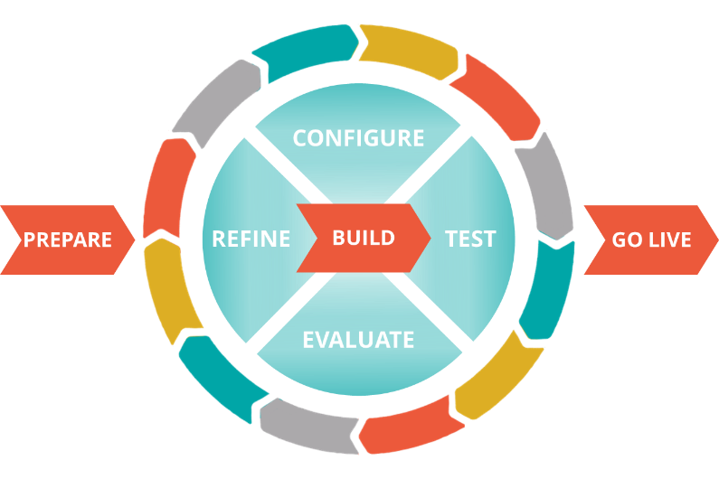
Co-production: Enabling Co-producers
Notes:
This deck supports a half-hour training event for Pega Mentors

Slide 2
Your guide
[presenter name]
[presenter job title/role]
[presenter contact info]

Slide 3
What is this module?
This is a training event to give new Pega Mentors an overview of their responsibilities in that role
It is intended primarily for
LSAs and SSAs
LBAs and SBAs
(appropriate Robotics roles)
(appropriate Decisioning roles)

Slide 4
What is Co-production?
Dedicated client staff working alongside Pega or Partner resources
Client team members participating actively in projects
Co-producers being mentored on Pega by Pega experts
Notes:
Co-production is solution delivery accomplished by dedicated client staff working alongside Pega or Partner resources
Client team members are active participants. They
Provide meaningful contributions to the delivery effort
Enhance their Pega skill set
Co-producers are mentored on Pega by Pega experts (Pega Consulting, Partners, or client resources) to
Gain proficiency over time
Ultimately become individually self-sufficient
Learn the “art of the possible” with Pega
This comes from Pega Academy’s “Introduction to Pega’s Delivery Approach 2018”, the “Be Journey-Centric and Adopt Co-Production” lesson.
Personal note: I like the way that source framed co-production as delivery accomplished first by client staff … ownership and accountability like that is all-to-often missing on projects.

Slide 5
What are its goals?
The client’s creation of internal Pega Champions
Client’s deep understanding of their Pega applications
Increased transparency of client’s solution-delivery efforts
Notes:
The creation of internal Pega Champions
Business users can configure exactly what they need to create a more relevant application
Internal IT resources can leverage their knowledge of the business and its existing software portfolio
Client’s deep understanding of their Pega applications
Knowledge of how an application was built stays within the organization
Increased transparency of client’s solution-delivery efforts
With in-house resources, the business has increased vision into what is being built
This is based on Pega Academy’s “Introduction to Pega’s Delivery Approach 2018”, the “Be Journey-Centric and Adopt Co-Production” lesson.

Slide 6
3 steps to successful Co-production
Develop an enablement plan
Enable co-producers
Track and report on progress
Notes:
Successful Co-production doesn’t just happen. Following these three steps will help ensure that the client effectively moves along the path to individual self-sufficiency

Slide 7
3 steps to successful Co-production
Develop an enablement plan
Enable co-producers
Track and report on progress
Notes:
This module will help Pega Mentors enable Co-producers

Slide 8
Enabling co-producers
Pega Mentors work with co-producers
Also meet weekly with co-producers to discuss individual progress against enablement plan
Develop an enablement plan
Enable co-producers
Track and report on progress

Slide 9
Who does what?
Simple screens
Complex UI
Robotics
Decisioning
Business process flows
Complex rules
Data pages
Interfaces
Functional testing
Non-functional testing
Key
Client/Partner staff
Client IT Staff
Pega/Partner and/or Client IT Staff
Notes:
Some aspects of Pega solution delivery are best handled by resources from Pega and Pega’s partners. But in reality, all of Pega solution delivery can theoretically be handled by resources within your organization. And bringing those resources to that point is what Co-production is all about.

Slide 10
The Pega Mentor
Services role
Solution-architecture mentoring
Typically an LSA or SSA
Business-architecture mentoring
Typically an LBA or SBA
Supports co-producers
20% for the first 3 months
10% for second 3 months
Notes:
The Pega Mentor is the role that is responsible for the actual knowledge transfer

Slide 11
Typical path to co-production: technical track
 | 0-3 months | 4-6 months | 7-9 months | 10-12 months
Pega Mentor time needed | 20% | 10% | 0% | 0%
Co-producer productivity | 40% | 60% | 80% | 100%
Co-producer commitments | Complete Pega training prior to Kickoff Take test for initial Pega certification within first month | Achieve initial Pega certification Complete advanced course material within 6 months | Achieve advanced Pega certification | Become 100% productive May act as Pega Mentor
Governance | Reviewed weekly | Reviewed fortnightly | Reviewed fortnightly | Reviewed monthly
Notes:
Mentoring in Co-production typically lasts for 6 months, with an additional 6 months for further skill development. Over that time the Pega Mentor’s involvement decreases as the co-producer’s skill increases.
Productivity is estimated to be the amount of work the co-producer can complete in a given amount of time as compared to the amount of work that an experienced Pega resource holding of an advanced Pega certification (such as Pega Certified Senior System Architect) would complete in the same amount of time.
Note that a Co-production Lead will be responsible for developing and tracking the enablement plan. The Pega Mentor role is responsible for actually mentoring co-producers.

Slide 12
What to teach?
Good understanding of the application
Design patterns
Reusable components
Simplified approaches
Efficient and effective testing

Slide 13
The right involvement in the project
10%
Formal learning - training
Experiential learning through action and experience
Specific deliverables for newly enabled resources
Start project directly after training ends to cement knowledge & understanding
Work shoulder-to-shoulder with expert resources
20%
Learning from others – coaches, mentors, feedback
70%
Learn by doing – through challenging assignments and experiences
Notes:
Over time, the influence of learning experience rapidly diminishes;
learners must find their way to on-the-job competence
Most people learn by doing; experiential learning tends to be the most easily retained. And with Co-production, the learner’s experience is constantly reinforced.
Experiences are supplemented with after-training support that’s contextual, just-enough, and ready when they are.
Co-production isn’t simply a good idea. It is a foundational tenant of how we implement our solutions.

Slide 14
Utilize training from Pega Academy
PEGA ACADEMY
SELF-STUDY TRAINING
MENTORED
SELF-STUDY
INSTRUCTOR-LED
TRAINING
Videos
Hands-On Exercises
Quizzes
Mentored Sessions
Monitored Progress
Exam Prep
Private Onsite
Virtual
Public Classroom
ROLE-BASED CURRICULUM
Horizontal and Vertical Training
Marketing
Sales & Onboarding
Customer Service
Industry Operations
Notes:
Co-production involves three learning models; the first is the Pega Academy.
Pega Academy makes training available however you want to learn
2.1 million lessons completed
55,000 courses completed
43000 unique students enrolled
21,000 certified students
33% Growth in the Active PDN community (YTD 2015 versus 2014)
NPS across courses in the mid 40’s

Slide 15
Make use of Pega Community
https://community.pega.com/
Notes:
The second model is the Pega Community … utilizing your peers with your organization and throughout the world to both find answers and to provide your expertise and insight.

Slide 16
Leverage extended learning
Brown-bags
Webinars
COE
PegaWORLD
Mentoring
Notes:
The third model of knowledge transfer is extended learning. For Pega projects, it typically takes four forms:
Coaching
Weekly informal classroom based sessions
Group based (~6 people)
Mentoring
Tailored 1:1 sessions with client resources to build functionality directly inside Pega
This should complement and embed learnings from the coaching sessions
PegaWORLD
Pega Academy training
Breakouts and Panel Discussions
In-depth workshops

Slide 17
Brown-bag events
Weekly, informal, classroom-based sessions
Group based (~6 people)
Often in a Lunch-and-Learn format

Slide 18
Ensure brown-bagging success
Stick to reality
Start with the easy stuff, growing to the more difficult over time
Give the co-producers real exercises
Work in a safe environment
Provide short lessons twice a week
Notes:
Stick to reality
Focus on what the client is currently building
Start with the easy stuff
Advance to the more difficult topics over time
Provide real exercises
Break something that is working; get the group to fix it….
Outline a new requirement; get the group to build it….
Work in a safe environment
One that will not break Dev
Provide short lessons twice a week

Slide 19
Mentoring
Tailored 1:1 sessions with co-producers to build functionality directly inside Pega
Complement and embed learnings from the coaching sessions
Notes:
The aim here is to encourage the client to do things in Pega as soon as possible.
Focused 1:1 time allows you to guide the client resource and help demystify our tool.

Slide 20
Ensure mentoring success
Show something new that aligns with the sprint goal, not just their enablement plan
Demonstrate Pega’s ease of use
Ensure Pega isn’t viewed as “just a developer tool”

Slide 21
Scaling for Success
Start Small…
Teach one team
Demonstrate delivered Pega outcomes
Then go larger…
SA
SA
SA
SSA
LSA
SA
UX
LBA
BA
BA
Notes:
Key Lessons
All resources can use Pega
Challenge the client to view using Pega as a key focus for all resources.
Don’t let the opportunity pass to empower BA’s, UX Design and UI Design resources to configure the application.
Embed the change
Offer coaching to stakeholder teams
MI Streams
Internal service providers
Operational input teams
Executives and Leads

Slide 22
Questions and wrap-up

Slide 23
Find more information on Pega Community
https://community.pega.com/knowledgebase/articles/identify-co-production-participants-and-start-enablement

