Slide 1
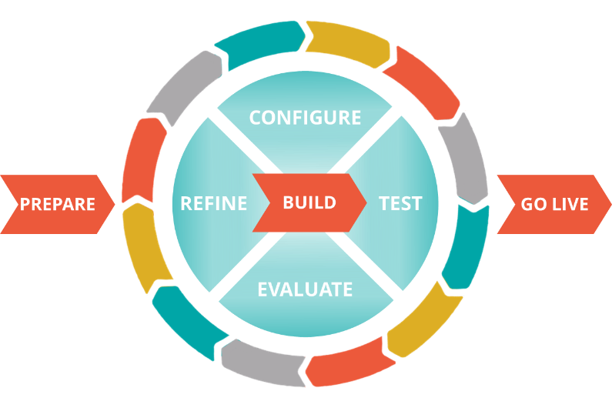
Co-production: Enablement Tracking & Reporting
Notes:
This deck supports a half-hour training event with examples for Co-production Leads

Slide 2
Your guide
[presenter name]
[presenter job title/role]
[presenter contact info]

Slide 3
What is this module?
This is a training event to give new Pega Co-production Leads an overview of their responsibilities in that role
It is intended primarily for
ELs
LSAs and SSAs
LBAs and SBAs
(appropriate Robotics roles)
(appropriate Decisioning roles)

Slide 4
What is Co-production?
Dedicated client staff working alongside Pega or Partner resources
Client team members participating actively in projects
Co-producers being mentored on Pega by Pega experts
Notes:
Co-production is solution delivery accomplished by dedicated client staff working alongside Pega or Partner resources
Client team members are active participants. They
Provide meaningful contributions to the delivery effort
Enhance their Pega skill set
Co-producers are mentored on Pega by Pega experts (Pega Consulting, Partners, or client resources) to
Gain proficiency over time
Ultimately become individually self-sufficient
Learn the “art of the possible” with Pega
This comes from Pega Academy’s “Introduction to Pega’s Delivery Approach 2018”, the “Be Journey-Centric and Adopt Co-Production” lesson.
Personal note: I like the way that source framed co-production as delivery accomplished first by client staff … ownership and accountability like that is all-to-often missing on projects.

Slide 5
What are its goals?
The client’s creation of internal Pega Champions
Client’s deep understanding of their Pega applications
Increased transparency of client’s solution-delivery efforts
Notes:
The creation of internal Pega Champions
Business users can configure exactly what they need to create a more relevant application
Internal IT resources can leverage their knowledge of the business and its existing software portfolio
Client’s deep understanding of their Pega applications
Knowledge of how an application was built stays within the organization
Increased transparency of client’s solution-delivery efforts
With in-house resources, the business has increased vision into what is being built
This is based on Pega Academy’s “Introduction to Pega’s Delivery Approach 2018”, the “Be Journey-Centric and Adopt Co-Production” lesson.

Slide 6
3 steps to successful Co-production
Develop an enablement plan
Enable co-producers
Track and report on progress
Notes:
Successful Co-production doesn’t just happen. Following these three steps will help ensure that the client effectively moves along the path to individual self-sufficiency

Slide 7
3 steps to successful Co-production
Develop an enablement plan
Enable co-producers
Track and report on progress
Notes:
This module will help Co-production Leads track and report progress against a Co-production enablement plan

Slide 8
Step 3: Track and report on progress
Discuss progress against planned effectiveness
Identify potential risks to planned effectiveness
Resolve development road-blocks
Agree next short term coaching topics and project tasks
Develop an enablement plan
Enable co-producers
Track and report on progress

Slide 9
What are we tracking?
Organizational progress toward increased understanding of their Pega solutions
Individual progress
Application knowledge
Skill development
Progress along career path

Slide 10
Who keeps an eye on all of this?
Simple screens
Complex UI
Robotics
Decisioning
Business process flows
Complex rules
Data pages
Interfaces
Functional testing
Non-functional testing
Key
Client/Partner staff
Client IT Staff
Pega/Partner and/or Client IT Staff

Slide 11
The Co-production Lead
Simple screens
Complex UI
Robotics
Decisioning
Business process flows
Complex rules
Data pages
Interfaces
Functional testing
Non-functional testing
Key
Client/Partner staff
Client IT Staff
Pega/Partner and/or Client IT Staff
Notes:
The Co-production Lead role is responsible for tracking and reporting on co-producers’ progress against the project’s Enablement Plan.

Slide 12
The Co-production Lead
Services role
Typically SSA or SBA
Sometimes EL
Occasionally LSA or LBA
Responsible for weekly tracking and reporting on co-producers’
Individual progress
Progress against the enablement plan
Report goes to Engagement Lead
Notes:
The Co-production Lead is the role that is responsible for tracking and reporting on co-producers’ individual progress and progress against the enablement plan.
On a small project, the EL or even LSA/LBA may take this role. For a project of any size, though, it is recommended that all three of those roles be allowed to focus on their primary roles. In particular, that the LSA and LBA be free to spend any available time in mentoring.
The administrative aspects of tracking and reporting – particularly on medium-to-large projects – can serve as a good grown opportunity for SSAs and SBAs looking for career growth

Slide 13
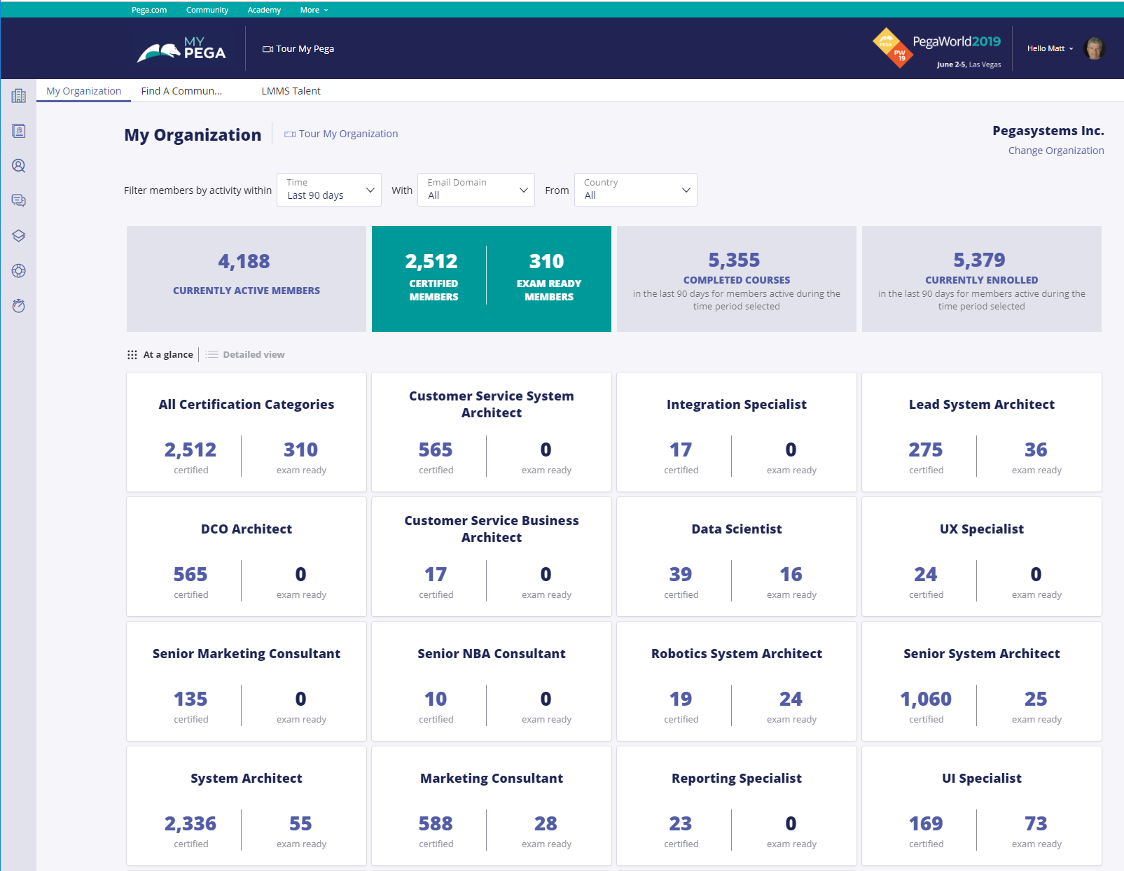
Enablement tracking
Go to My Pega from any Pega site
Choose My Organization
Notes:
This report is available from My Pega and should be updated weekly.

Slide 14
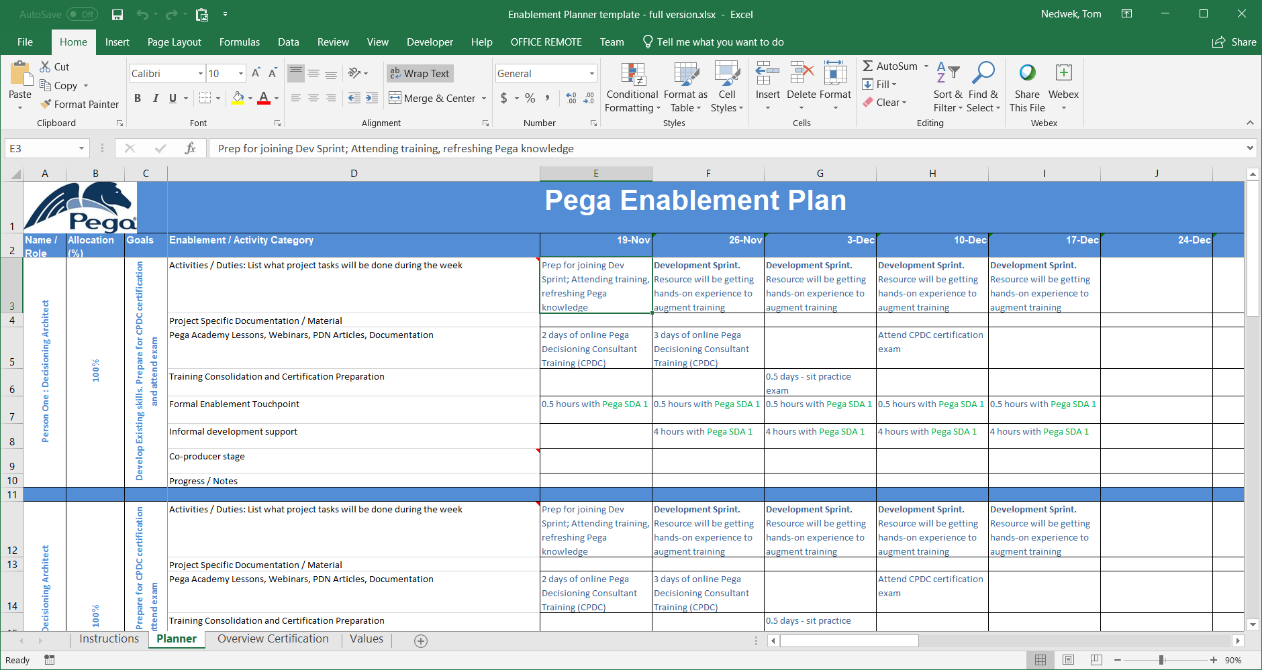
Enablement Plan Option 1: Full Version
Notes:
This version is typically used at the start of the project.

Slide 15
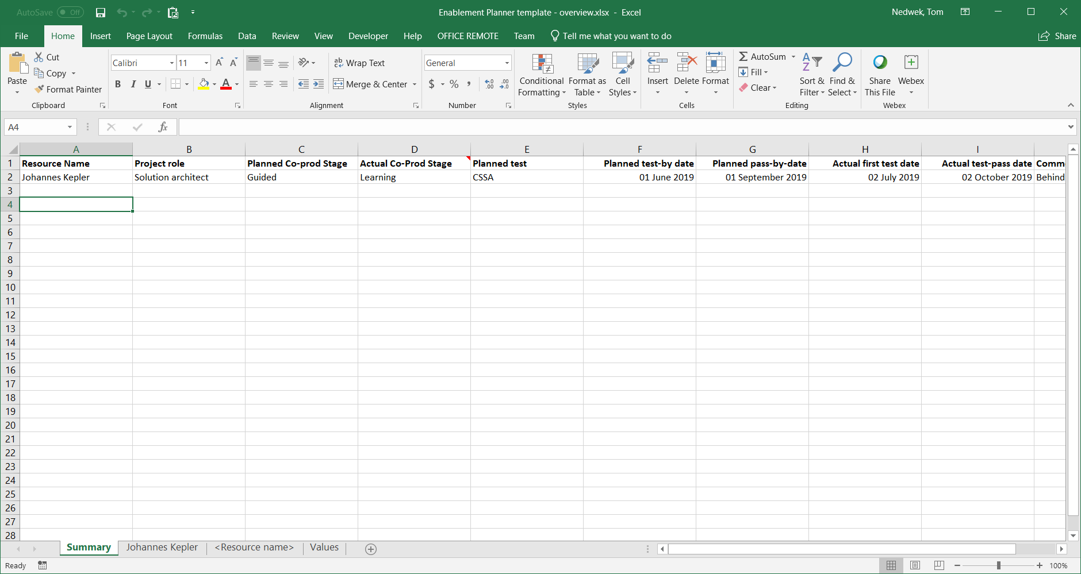
Enablement Plan Option 2: Overview
Notes:
This version can typically be used later in the project, when the co-producers are self-sufficient not only in their Pega skills but in their individual enablement as well.

Slide 16
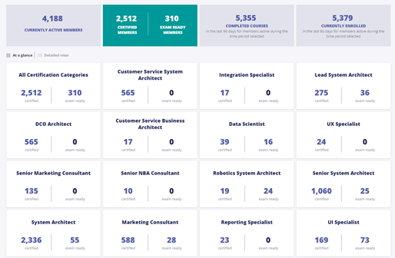
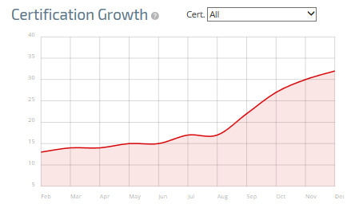
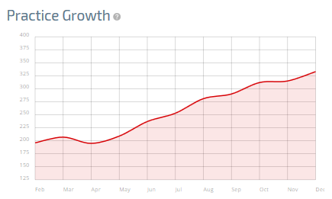
Co-production in Project Status Report
Client staff name | Target activities | Next goal | Due date | Status | Back to green actions
Kerr Avon | Security testing | Penetration test | 2 Nov 2018 | G
Villa Restic | Acquisition user story | Take over as lead for acquisitions | 18 Dec 2018 | G
Overall status
Co-production resources are working as part of the development team 1 missing resource based on agreed price. Need to agree if this work will be done by Pega via change control or we change scope.
Current | Prior
G | Y
Notes:
Progress against the enablement plan will be tracked on a weekly basis as part of the Project Status Report. The Engagement Lead may ask the Co-production Lead to fill out this slide.
Call out any issues with co-production. If Co-production has issues and Pega has to do more work then we need to agree if we deal with this by changing scope / more paid effort from Pega or some other solution.

Slide 17
Questions and wrap-up

Slide 18
Find more information on Pega Community
https://community.pega.com/knowledgebase/articles/identify-co-production-participants-and-start-enablement

