Slide 1
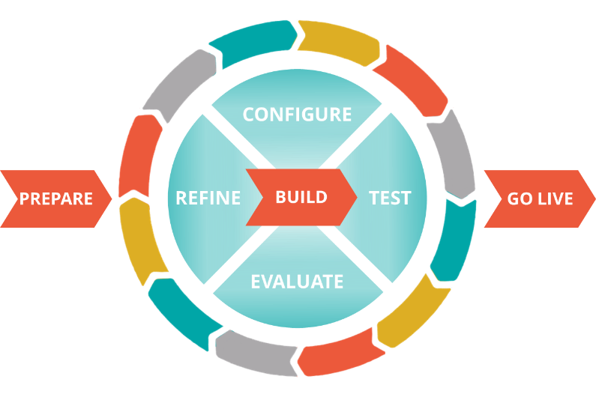
Journey Centric Delivery: Embracing Change
Notes:
Version 1.1, last modified 9/12/2019
This deck supports a 30-minute discussion of handling change in JCD efforts for clients, partners, Pega salespeople, and Pega Consulting professionals

Slide 2
What is this module?
This deck discusses handling change in efforts utilizing Journey Centric Delivery
It is intended for a broad audience, including
Customers
Clients
Partners
Pega salespeople
Pega Consulting professionals

Slide 3
Rule #1: Don’t avoid change
Embracing change is an agile practice because it’s a good idea.
Adaptiveness creates a performance gap between the top performers and the rest of the pack
Pega’s company motto is “Build for Change”, not “Build for status quo”
Notes:
The idea behind the first point is that being responsive to change is valuable on its own. Not just because it’s (hopefully) associated with agile solution delivery efforts.

Slide 4
Rule #2: Do handle change wisely
Embracing change doesn’t mean embracing chaos
Scrum and Journey Centric Delivery are designed to handle change – even welcome it – with discipline

Slide 5
Rule #3: Keep these constant during a sprint
Sprint length
Sprint goals
Definition of Ready
Definition of Done
Team composition
Notes:
Definition of Ready - ready for development
Helps ensure that the stories at the top of the Product Backlog are ready for estimation during sprint planning
Definition of Done - ready for Product Owner’s acceptance
The exit criteria, or a governing agreement that guides all development activities
Defines potentially implementable functionality, so must include QA testing
Defined by each team; may vary among teams
May also differ from one sprint to another depending on the type and scope of the sprint
Can have different DoDs for user stories, tasks, and releases

Slide 6
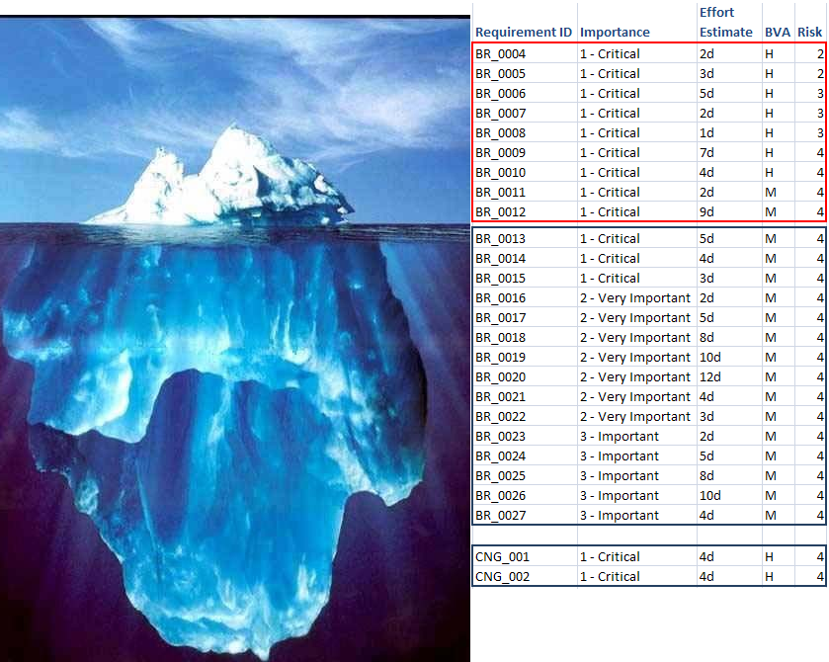
Backlogs are great for handling change
In Scope for Current Release-
Total Effort Estimate: 35 days
Future Release
Proposed Changes added to Backlog

Slide 7
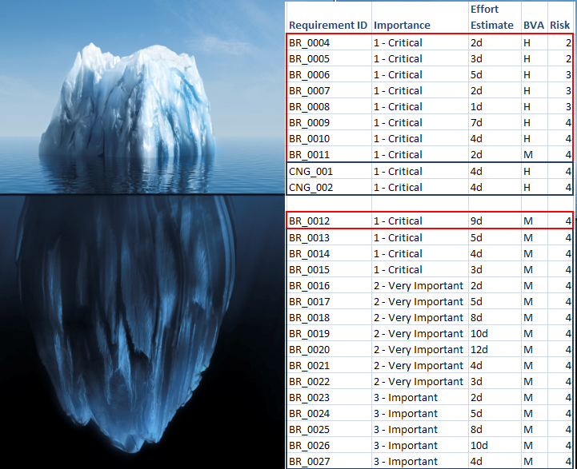
Incorporating changes into future sprint
Current Scope
Changes
De-Scoped Item
Future Release

Slide 8
Product Owner
Your Product Owner must be empowered to make these prioritization decisions
If your PO needs approval before proceeding, then means that your PO is not sufficiently empowered
And that is a sign of trouble

Slide 9
Change log versus change control process
Change log: written documentation of what has changed on a project and (briefly) why
Pega recommends that all changes to the project – changes in scope, in resources, in schedule, in cost – be documented in a change log
The log can be invaluable when understanding or justifying a particular change
Change control process: the mechanism that supports the initiation, recording, assessment, approval, and resolution of project changes
Pega recommends that a change control process be part of the governance plan developed at the beginning of a project
Notes:
Example of a change log? Talk to Josh and Ralph

Slide 10
Do I still need a change control process?
Yes … and it doesn’t matter what type of methodology you’re using
Even agile projects need a change control process
The important question is not whether you need a change control process, but when you need it

Slide 11
Not every change needs a change control process
If your PO approves the change, AND
Your team hasn’t started working on it yet, AND
The change only affects your team
Then you don’t need to go through a change control process.
Document the change in the project’s change log
Add backlog item(s) to describe the change
Allow the PO to prioritize them
Notes:
Proposed changes like those described above don’t require a change control process, though they should still be documented in the project’s change log.
If all of the above are true, the proposed change can stay within a Scrum team.

Slide 12
You DO need a change control process when …
Stakeholders want to swap new work for work already completed, OR
Stakeholders want to swap something big for something small*, OR
The proposed change adversely affects another team
This might not be a case of simply causing them additional work
For example, when implementing a proposed change would delay development of a capability on which that other team depends
*Swapping something small for something big does not require utilizing the change control process, but it does still involve recording the change in the project’s change log
Notes:
Proposed changes like those described above do require a change control process
If any of the above are true for a proposed change, it needs to go through a change control process

Slide 13
So even agile projects need a change control process
They just don’t need it as often as some people think

Slide 14
Governance
Corporate
Program Sponsor
Project
Team
The change control process is part of the multi-level governance agreed to at project start
A discussion about the details of change management must be held with the client before the program starts
It is part of the weekly project-level governance meeting
Resolves
Raises
Notes:
The discussion is necessary to determine whether the client will allow change to be handled in an agile way, or whether the client is plan-driven (in which case much stricter controls must be in place).

Slide 15
What about creating change requests?
Even for a proposed change that stays within the Scrum team, if implementing it involves a change to a contractual agreement a change request is required
Impact to the agreement could involve
Scope
Deliverables
Cost
Assumptions
For example, Dependencies
There are 3 types of change requests …
Notes:
Clarify what we mean in 2nd bullet

Slide 16
Type 1. Commercial/Contractual Impact
Any change that affects the contract or Statement of Work must go through the change control process
Examples
Customer changes project timelines or milestone dates
Customer asks to swap out functionality if functionality is included in the Statement of Work
Customer adds scope/functionality
Customer requests simple contractual end-date change to allow for billing beyond the contract’s end date (not because the project is late)

Slide 17
Type 2. No commercial impact, no approval needed
Per the discussion above, some changes can be approved by the relevant Product Owner alone
The proposed change must meet all of the following criteria:
The Product Owner approves the change
The Scrum team has not started working on it yet
The change affects only that Scrum team
The change must still be documented in the project’s change log

Slide 18
Type 3. No commercial impact, approval required
Pega recommends that some proposed changes go through the change control process even if they have no commercial or contractual impact
Examples:
Change of branding
Impact to another project
Impact to another Scrum team

Slide 19
A growing backlog is not a problem
A growing backlog can – within reason – be a very good thing
It means that the business and technical teams are thinking and observing
Remember: the fact that an item is in the backlog doesn’t mean that it will be delivered

Slide 20
Tips for embracing change
Product owner is the custodian of change in an agile environment
Make sure that embracing change is expected from project inception
Project Charter / Kickoff
Clear roles & responsibilities
Product Owners, Stakeholders in Reviews, Teams, etc.
Guardrails for a change management board
Expected behaviors for change
Hold those involved to expected behaviors during product builds
Especially for management and customers/stakeholders
Takes greater discipline to be self-organized
With great power comes greater responsibility…

